Slide 1
Chapter 1: Introduction
1.1. Images and Pictures
An image is worth thousands of word

Slide 2
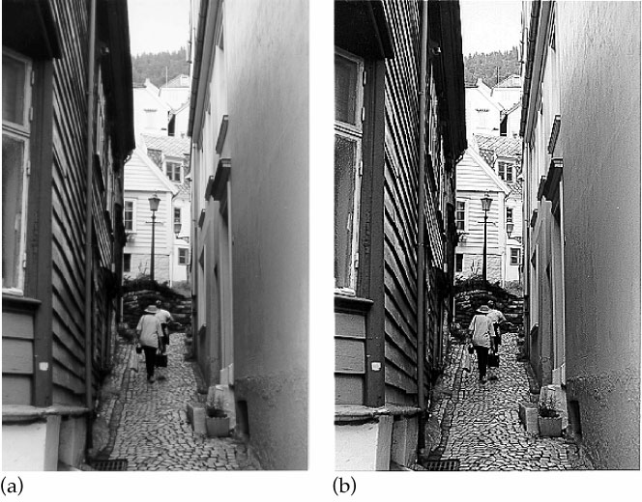
1.2 Image processing – change the nature of an image
Objectives: (a) human interpretation
(b) machine perception
Human interpretation
Image sharpening

Slide 3
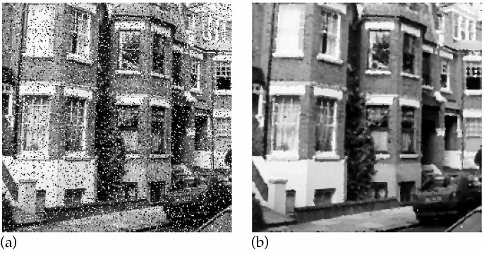
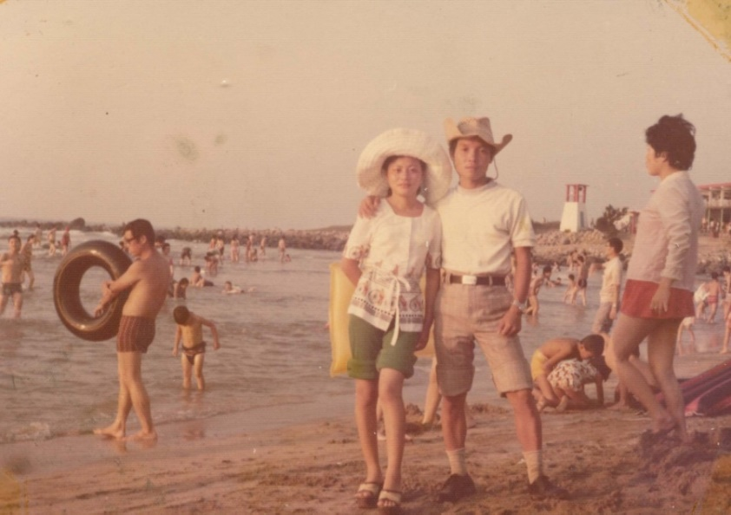
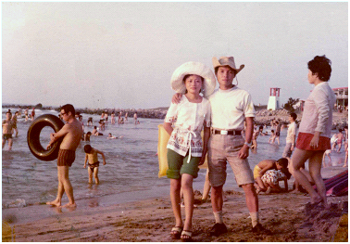
Noise removal
Deblurring

Slide 4
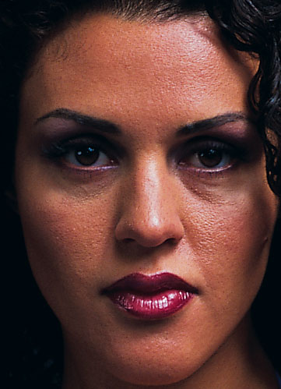
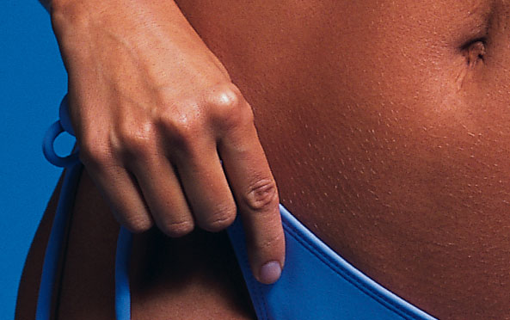
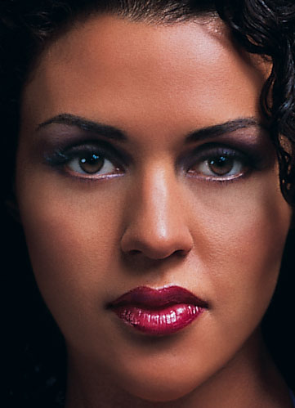

Before
After

Slide 5
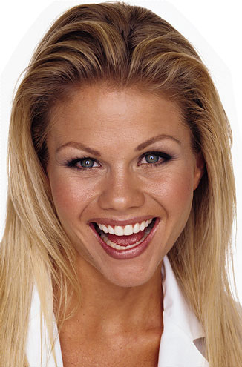
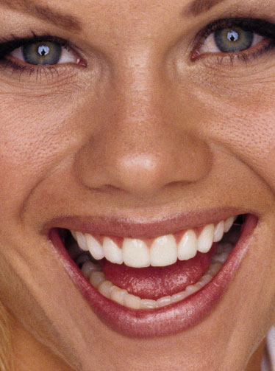
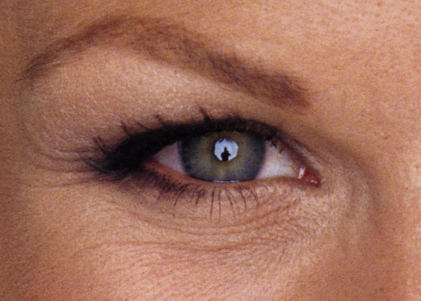
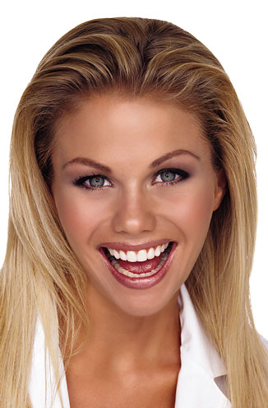
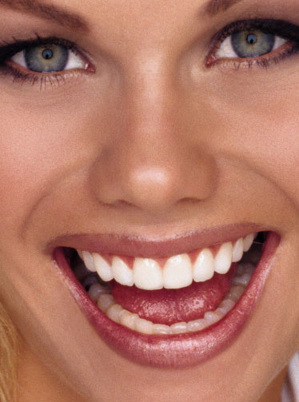
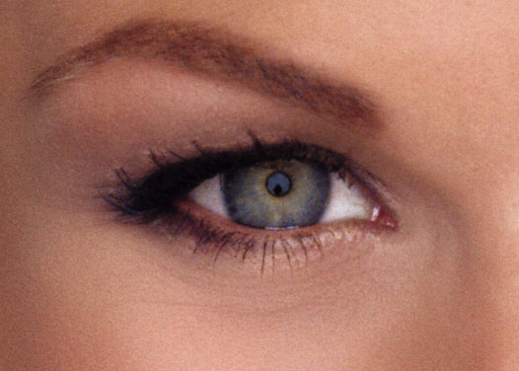
Before
After

Slide 6


For you, ...not much can be done!

Slide 7
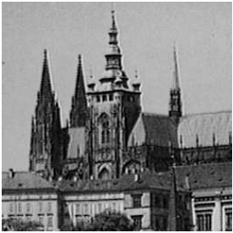
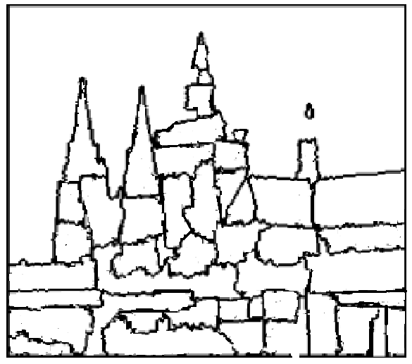
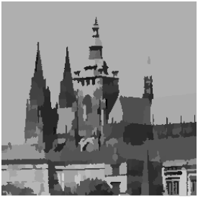
(B) Machine perception
Input image
Edge detection
Image segmentation

Slide 8
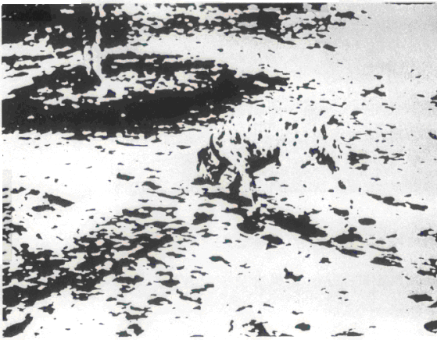


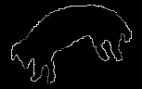


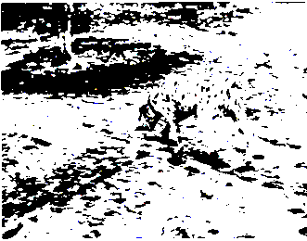
Example: scene understanding
Thresholding, Noise removal
Group ─ form significant regions
Cluster ─ associate with objects
Segment ─ locate primary areas
Edge detection , Edge following
. . . . . . . . . . . . .
Input image
Thresholding
Edge detection
Edge following
Segmentation
Grouping,
Clustering

Slide 9
Three levels of image processing:
Low-level processing –
e.g., threshold, noise removal (smoothing)
contrast enhancement (sharpening)
Mid-level processing –
e.g., grouping, clustering,
edge detection, image segmentation
High-level processing –
e.g., object recognition
scene understanding

Slide 10
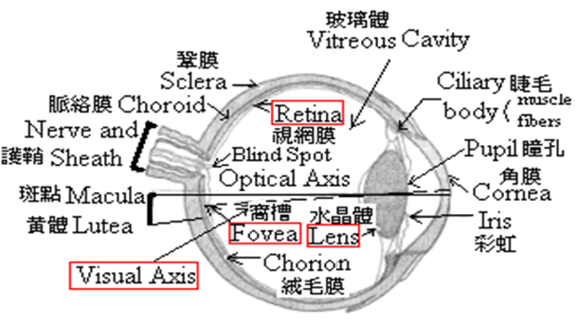
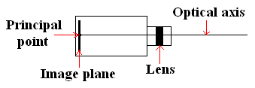
1.3.1 Image Acquisition
1.3 Image Acquisition and Sampling
Human eye
Cameras
Notes:
acquisition獲得
Optical axis 光軸

Slide 11

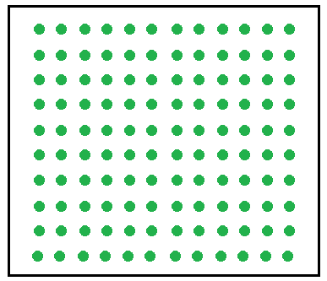
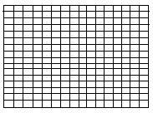
Digital cameras
CCD (charge-coupled device) cameras,
CMOS (complementary metal oxide
semiconductor) camera
Image
plane
Sensor array
Image array
Notes:
感光元件密度高-解析度高
感光元件密度低-解析度低

Slide 12
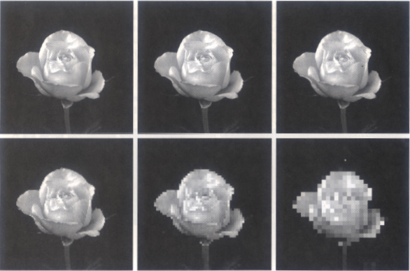
1.3.2 Sampling
-- transforms a continuous function into a discrete one
Spatial Resolution
Notes:
spatial resolution-感光元件的密度

Slide 13
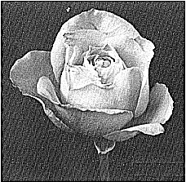
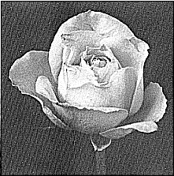
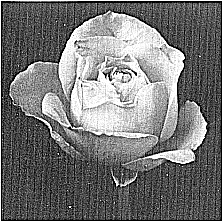
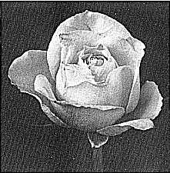
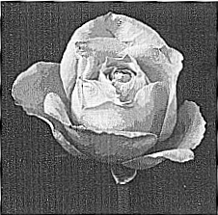
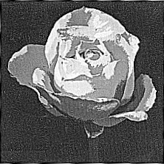
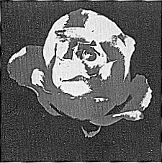
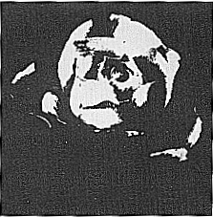
Grayscale resolution (Quantization)
False contours
Notes:
光的強度分成好幾階0(暗)-255(亮),不同階就是不同resolution
一般分256階
False contour-主要因為grayscale resolution 低所產生(本不該存在的contour 卻存在)

Slide 14
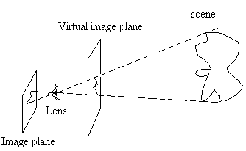
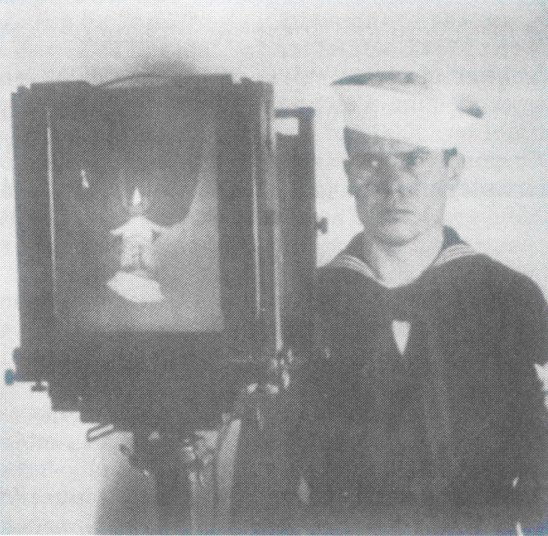
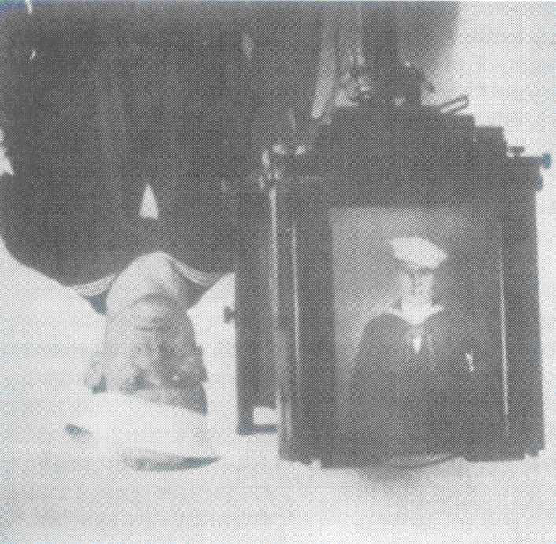
1.4 Images and Digital Images
Imaging model

Slide 15
Scene: a 3-D continuous function, g(x,y,z)
Image: a 2-D continuous function, f(x,y)
Digital image: a 2-D discrete function, I(r,c)
Origin
○
c
r
Pixel: picture element
Gray level: pixel value (0 – 255)

Slide 16
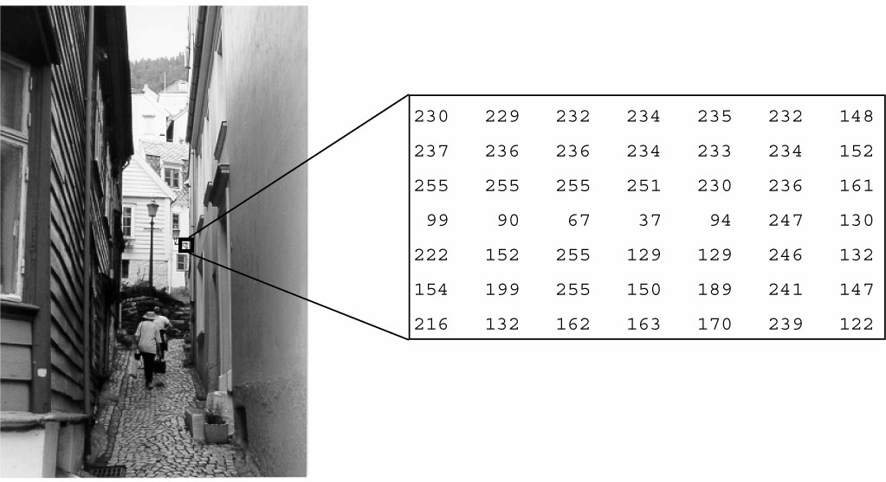
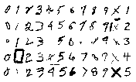
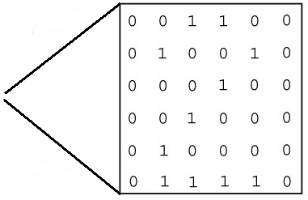
1.8 Types of Digital Images
Grayscale image
Binary image

Slide 17
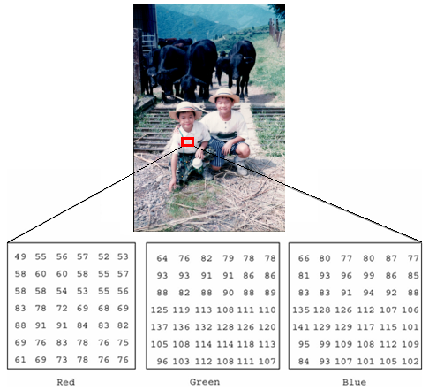
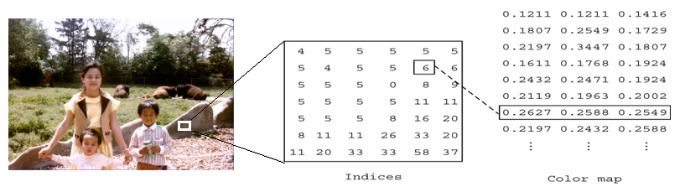
Color image
Indexed (or palette) color image
Notes:
rgb各1byte
Indexed (or palette) color image 中color map 值要乘256
palette調色板

Slide 18
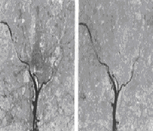
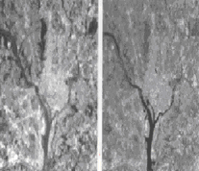
Multispectral images

Slide 19
Radio images
Notes:
radio image –長波影像

Slide 20
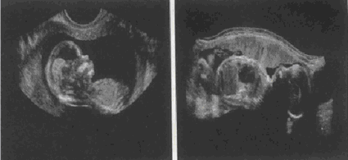
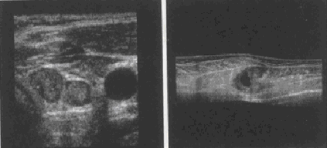
Ultrasound images
Notes:
Ultrasound images 超音波影像

Slide 21
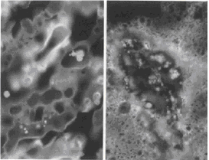
Ultraviolet images
Notes:
Ultraviolet images –紫外線影像,通常分析細菌、植物

Slide 22
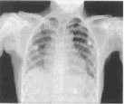
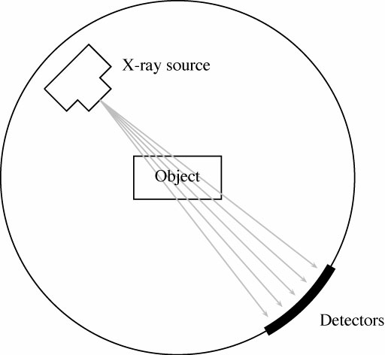
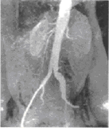
X-ray image

Slide 23
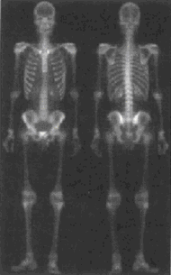
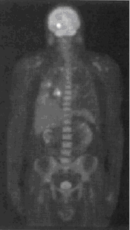
Gamma-ray images

Slide 24



X-ray transmission computerized tomography (CT) image
Notes:
transmission-傳遞
computerized-電腦化的
tomography -斷層攝影法

Slide 25






Range images
Notes:
range影像-距離的影像

Slide 26



Moire images
Notes:
Moire images – 未破壞性之檢測(ex:檢查橋樑有無偷工減料,光打過去,看車子過去時干擾條紋震動情況,動得很厲害-->weak)

Slide 27

Structure light images

Slide 28





Slide 29
Biological images
Cattles
Horses
Chickens
Owls
Bees, Flies, Grasshoppers
Snakes
Fishes

Slide 30
Examples: i) 512 by 512 binary image:
1.9 Image File Sizes
ii) 512 by 512 greyscale image:
iii) 512 by 512 color image:

Slide 31



-- Limitations of human visual system
1.10 Image Perception
Simultaneous
contrast
Optical
illusion
Notes:
illusion –幻覺、錯覺

Slide 32



Overshoot and Undershoot
Subjective
objects
Notes:
overshoot:過衝，也稱超調^{[1]}，是指訊號或者函數超過了預期值，是暫態響應的特性之一
訊號處理中:
overshoot:過衝,一濾波器輸出的最大值比輸入的最大值大
Undershoot:下衝,一濾波器輸出的最小值比輸入的最小值小

Slide 33

1-33

Slide 34

1-34

Slide 35

1-35

Slide 36

1-36

Slide 37

1-37

Slide 38

1-38

